Slide 1

Applying ML on Wind Turbine Data
Shreya Bhattacharya

Slide 2
Problem Statement:
Imagine Toqua wants to expand its services to the wind industry (wind turbines) and gives you free rein to decide on what to do and how to do it. Toqua has seen that Engie has an open data set available online and Engie’s head of Wind Turbines has agreed to take a meeting with Toqua in 2 weeks out of curiosity. Toqua has given you one week to take this dataset and make the best out of it. The goal is to prove that given this type of data, ML can create value for a player like Engie. We expect that by the end of the week you can give a technical presentation to your colleagues at Toqua on what results you achieved, how you achieved them and what interesting aspects you would have researched if you had more time - first from a technical perspective - and then finally suggest how we can use these results to convince Engie’s Head of Wind Turbines in the following week.
Deliverables:
Your documented code.
A slide deck you could use to pitch your results to your colleagues at Toqua.
Anything else you want to add.

Slide 3


DATA
Pitch
Angle
Rain
Active Power
Snow
Internal Parameters
Nacelle Temperature
External Parameters
Temperature
Nacelle Angle
Wind Speed
Reactive Power
Wind Direction

Slide 4

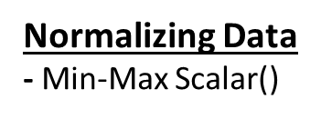

Train-Test Split
- train_test_split(wt, train_size = 0.8, test_size = 0.2, random_state = 100)
One hot Encoding
- Season
- Period of the day (morning, afternoon, evening, night)
Data Processing
Feature Engineering
- Hour of the day
- Day of the week
- Month
- Season
- Year
- Period of the day (morning, afternoon, evening, night)
Feature Selection
Recursive Feature Elimination (RFE)
Correlation Matrix
Feature Importance from tree-based models

Slide 5
Check for Null values: df.info
Check the data statistics: df.describe()
Outlier Detection: Box Plots of different predictor variables and target variables with respect to each season
Checking the Homogeneity of Each Turbine Data: Line Plots of different parameters grouped by different turbines to see if data can be combined for the model
Feature Distribution: Distribution plot to see if any data is skewed or asymmetric.
Checking Correlation: Correlation Matrix to see if any variables are strongly correlated with each other and dropping them to reduce redundancy.
Exploratory Data Analysis:

Slide 6
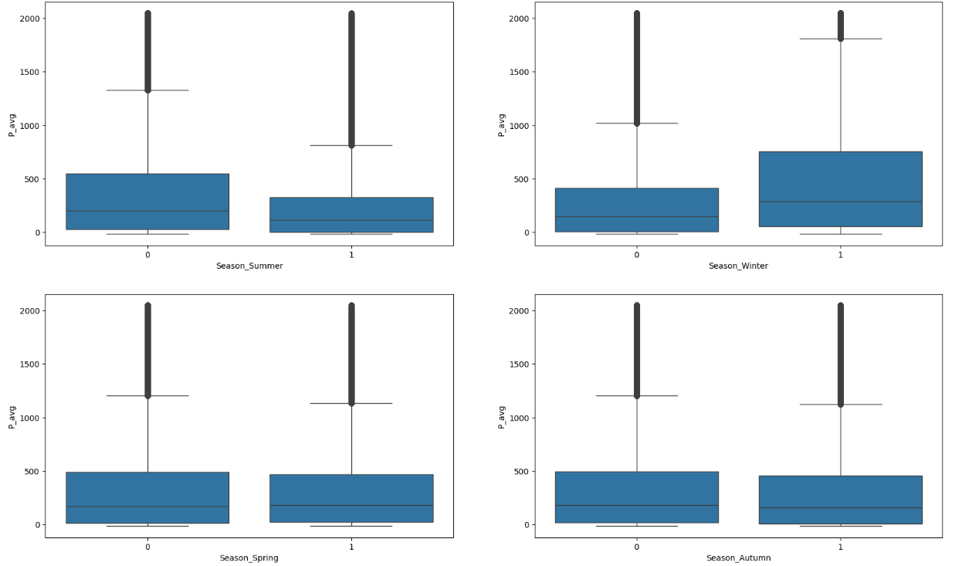
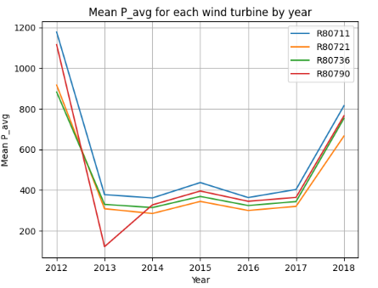
Data Visualization

Slide 7
Identified Business Problem I

Slide 8



The objective is to forecast power output (P) from a wind turbine based on, environmental factors such as wind speed, wind direction, outdoor temperature, pressure, humidity, rain, snow, season, and time of day.
A predictive model is developed using machine learning techniques, incorporating the mentioned features. Various regression algorithms such as linear regression, decision trees, or ensemble methods like random forest is evaluated to find the most accurate model.
Problem Statement
The Resolution
The Outcome
The trained model will then be used to forecast the power output based on the current environmental conditions. This forecasting capability will aid in optimizing wind turbine operations, scheduling maintenance, and ensuring efficient energy generation.

Slide 9
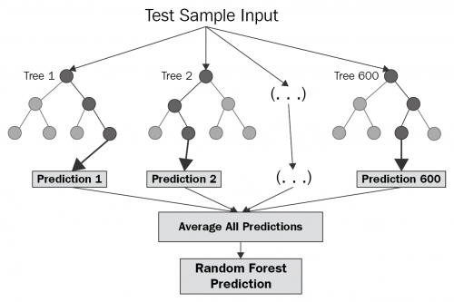
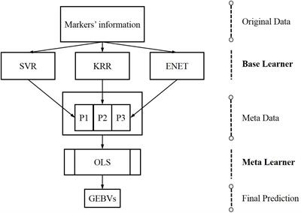
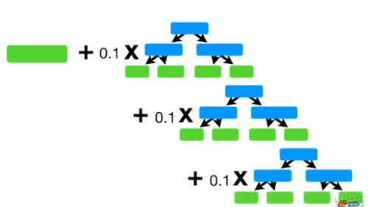
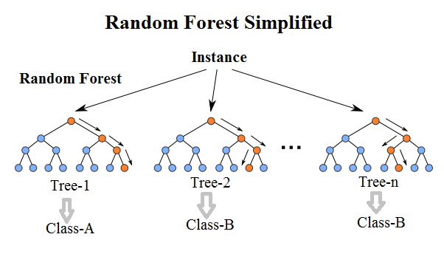
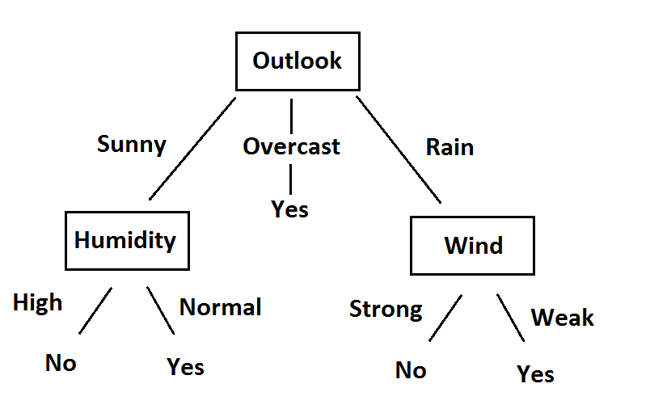
Machine Learning Models
Linear
Regression
Decision Tree
Random Forest
Custom Ensemble
Boosting-GBM/XG
Stacking
Environmental factors (wind speed, wind direction, temperature, humidity, rain, season, etc….)
Predictor Variables
Target Variable
Output Power

Slide 10
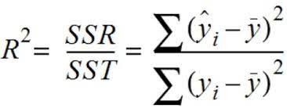
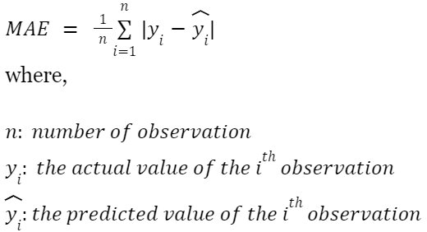
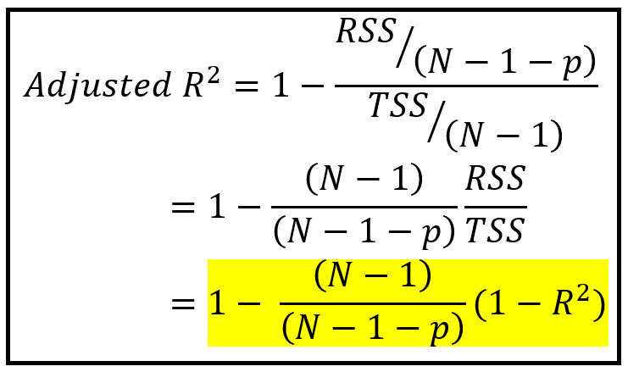
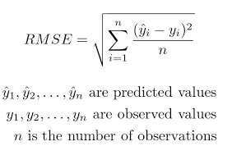
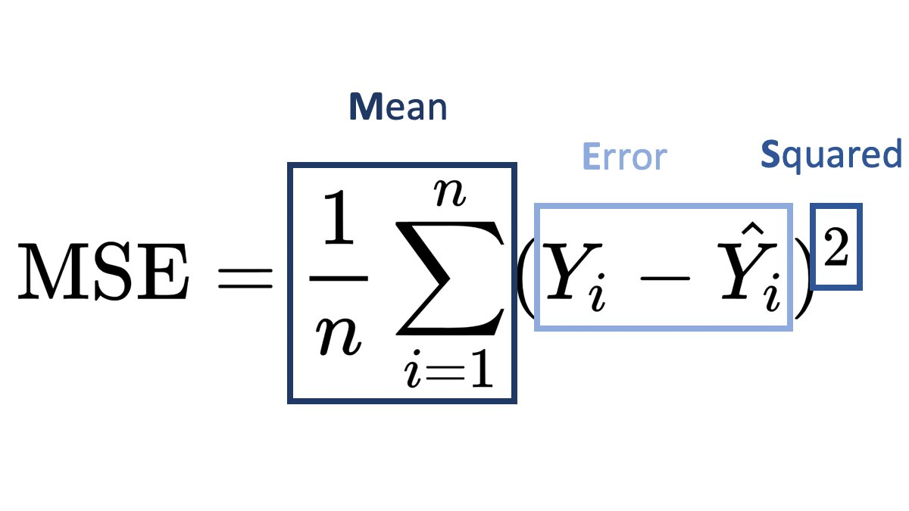
Metrics
R-Squared
Adjusted R-Squared
Mean Squared Error (MSE)
Root Mean Squared Error (RMSE)
Mean Absolute Error (MAE)

Slide 11
Results:
Method | R2(Train) | R2(Test) | Adjusted_R2(Train) | Adjusted_R2(Test) | Mean Absolute Error (Train) | Mean Absolute Error (Test) | Mean Squared Error (Train) | Mean Squared Error (Test) | Root Mean Squared Error (Train) | Root Mean Squared Error (Test)
Simple Linear Regression | 0.552 | 0.554 | 0.552 | 0.554 | 0.100 | 0.100 | 0.020 | 0.019 | 0.140 | 0.139
Decision Tree | 0.878 | 0.865 | 0.878 | 0.865 | 0.042 | 0.044 | 0.005 | 0.006 | 0.073 | 0.077
Random Forest | 0.878 | 0.865 | 0.878 | 0.865 | 0.042 | 0.044 | 0.005 | 0.006 | 0.073 | 0.077
XG Boost | 0.689 | 0.686 | 0.689 | 0.686 | 0.080 | 0.080 | 0.014 | 0.014 | 0.116 | 0.117
Gradient Boosting | 0.613 | 0.615 | 0.613 | 0.615 | 0.090 | 0.090 | 0.017 | 0.017 | 0.130 | 0.129
Stacking | 0.878 | 0.865 | 0.878 | 0.865 | 0.042 | 0.044 | 0.005 | 0.006 | 0.073 | 0.077
Ensemble | 0.739 | 0.736 | 0.739 | 0.736 | 0.073 | 0.073 | 0.011 | 0.011 | 0.107 | 0.107

Slide 12
Points of Improvement
Grid Search/ Random Search on hyperparameters
Instead of using a Box plot for outlier detection, we can use the 3 Standard Method or Interquartile range method
Tuning the hyperparameters on the Validation Set.
params = {
'max_depth': [2, 5, 10, 20],
'min_samples_leaf': [5, 10, 20],
"splitter":["best","random"],
"max_leaf_nodes":[None,10,20,30]
}
grid_search = GridSearchCV(estimator=dt,
param_grid=params,
cv=4, n_jobs=-1, verbose=1, scoring='neg_mean_squared_error')
Q1 = df[col'].quantile(0.25)
Q3 = df[col'].quantile(0.75)
IQR = Q3 - Q1
# identify outliers
threshold = 1.5
outliers = df[(df[‘col'] < Q1 - threshold * IQR) | (df[‘col'] > Q3 + threshold * IQR)]

Slide 13
Identified Business Problem II

Slide 14
Optimizing operational parameters, primarily the pitch angle and other influencing factors, can maximize wind turbines' power output.
Develop a regression model to predict wind turbine power output (Active_power) based on various operational parameters. Train the model on the given data to optimize the pitch angle and other operational parameters for maximizing power output.
Problem Statement
The Resolution
The Outcome
Use the regression model to provide real-time recommendations for adjusting operational parameters to optimize power output. In other words, this model takes the desired power as input and gives the optimal parameters required to achieve that output.

Slide 15
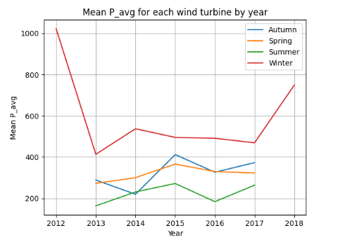
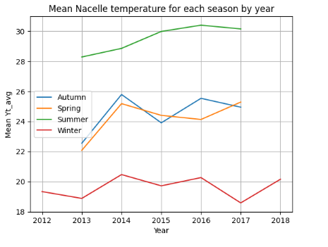
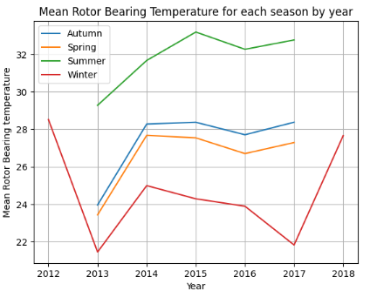
Exploratory Data Analysis

Slide 16
Machine Learning Models
Linear
Regression
Decision Tree
Random Forest
Internal parameters (pitch Angle, Rotor Speed, Nacelle Temperature, etc)
Predictor Variables
Target Variable
Output Power

Slide 17
Metrics
R-Squared
Adjusted R-Squared
Mean Squared Error (MSE)
Root Mean Squared Error (RMSE)
Mean Absolute Error (MAE)

Slide 18
Results
Method | R2(Train) | R2(Test) | Adjusted_R2(Train) | Adjusted_R2(Test) | Mean Absolute Error (Train) | Mean Absolute Error(Test) | Mean Squared Error (Train) | Mean Squared Error(Test) | Root Mean Squared Error (Train) | Root Mean Squared Error (Test)
Simple Linear Regression | 0.996251 | 0.996245 | 0.996251 | 0.996245 | 0.01071 | 0.010717 | 0.000163 | 0.000163 | 0.012777 | 0.012783
Decision Tree | 1 | 0.999945 | 1 | 0.999945 | 1.20E-07 | 0.000676 | 3.49E-11 | 2.39E-06 | 5.91E-06 | 0.001546
Random Forest | 0.999996 | 0.999967 | 0.999996 | 0.999967 | 0.00018 | 0.000485 | 1.88E-07 | 1.42E-06 | 0.000434 | 0.001192

Slide 19
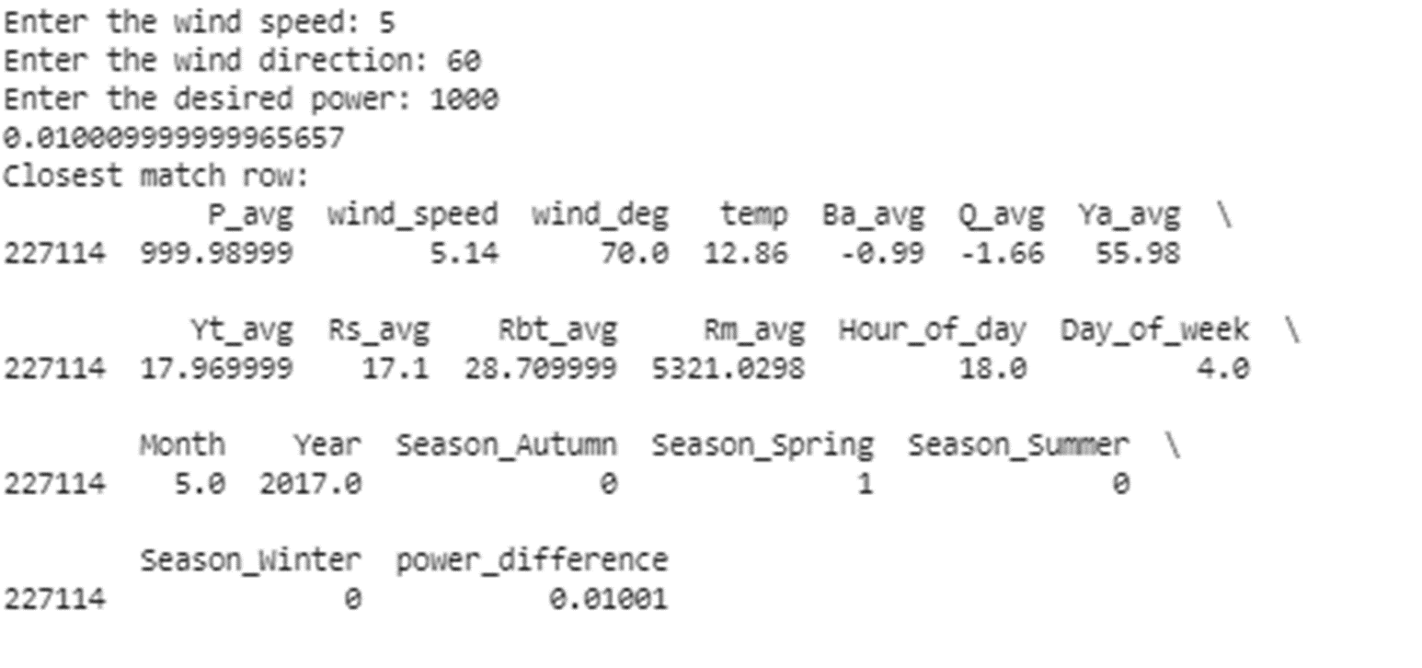
Retrieving Input Variables for Desired Power Output
Enter the wind speed
Let’s say 5
Enter the Wind Direction
Let’s say 60
Enter the temperature
Lets say 15
Enter other known parameters
Enter the Desired Power Output
Parameter Value
1000

Slide 20
Points of Improvement
Grid Search/ Random search on hyperparameters
More domain knowledge to see if all these parameters can be controlled
More Refined Functions to retrieve the optimum parameters:
Initiated Function by incrementing the input values and predicting from the pre-trained model to get the desired output.

Slide 21
Identified Business Problem III

Slide 22
Accurately predicting the gearbox oil temperature trend is critical for early fault detection and ensuring the safety and reliability of wind turbine gearboxes. Fluctuations in gearbox oil temperature can indicate potential issues, but these changes are influenced by various factors such as ambient temperature, active power, average wind speed, and seasonality
We propose to address this problem by analyzing the given data so that we can identify patterns and correlations between gearbox oil temperature and other relevant variables. Specifically, we will consider the following parameters:
1. Gearbox Oil Temperature: This is the primary variable of interest, influenced by internal heating and cooling mechanisms, as well as external factors such as ambient temperature.
2. Ambient Temperature: Variations in ambient temperature significantly impact gearbox performance, affecting both oil and bearing temperatures.
3. Active Power: Higher active power levels indicate increased load on the gearbox, leading to higher temperatures.
4. Average Wind Speed: Wind speed directly affects gearbox rotation speed, influencing oil temperature and overall performance.
5. Seasonality: Seasonal variations can also impact gearbox operation and temperature trends.
Problem Statement
The Resolution
The Outcome
We aim to develop a predictive model that accurately forecasts gearbox oil temperature changes by conducting similarity analysis and considering seasonal patterns. This model will enable proactive maintenance scheduling and early fault detection, ultimately enhancing the reliability and longevity of wind turbine operations.

Slide 23
Identified Business Problem IV

Slide 24
The challenge is to predict the power output of wind turbines based on various operational variables and classify whether the turbine is faulty or functioning properly. Using the theoretical power curve as a reference, the objective is to leverage other relevant variables to accurately forecast the power output and assess the turbine's health status.
Develop a classification model using machine learning algorithms to estimate the power output of wind turbines and classify their operational status. Utilize a dataset containing variables such as wind speed, temperature, pressure, and humidity, along with the theoretical power curve data. Train the model on the given data to learn the relationship between these variables and the power output while also incorporating information about turbine failures
Problem Statement
The Resolution
The Outcome
Once trained, the model can predict the power output and classify the turbine's health status (faulty or non-faulty) based on real-time operational variables. This approach enables proactive maintenance and optimization of wind turbine performance, minimizing downtime and maximizing energy generation efficiency.

Slide 25
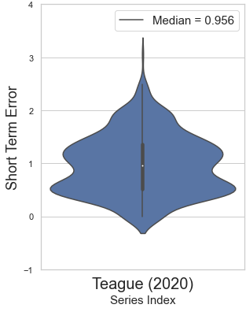
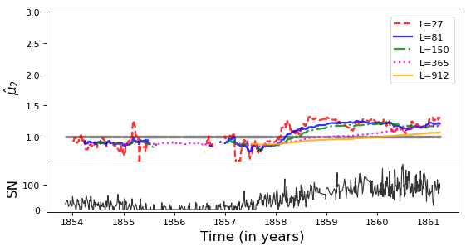
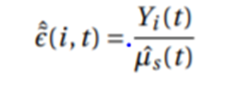
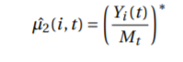
Identified Business Problem V
Check the stability of long-running Wind Turbines
Solution
Yi(t) are the raw daily Power Output from Wind Turbine A, Mt is the Theoretical power Curve and * denoted the smoothing process involving the moving average over L days
The closer it remains to 1 , more stable is the series.
Yi(t) is the daily Power Output of the series whose short-term error is to be determined, and µˆs(t) is the Theoretical Power Curve
Median closer to 1, more homogeneous is the series

Slide 26
Thank You

